Slide 1
Operating Systems
2. Process Concept
2-Process
1

Slide 2
Process: The Concept
Process = A program in execution
Execution progress in a sequential fashion
Example processes
OS kernel
OS shell
Program executing after compilation
www-browser
Process management by OS
Allocate resources
Processor, main memory, I/O modules, timers, …
Schedule: Interleave their execution
Watch for processor utilization, response time
Inter-process communication, synchronization
Check potential deadlocks
Interleaving and non determinism imply increased difficulties!

Slide 3
The Process
A process consists of multiple parts
Program code, also called text section
Current activity including program counter, processor registers
Stack containing temporary data
– Function parameters, return addresses, local variables
Data section containing global variables
Heap containing memory dynamically allocated during run time

Slide 4
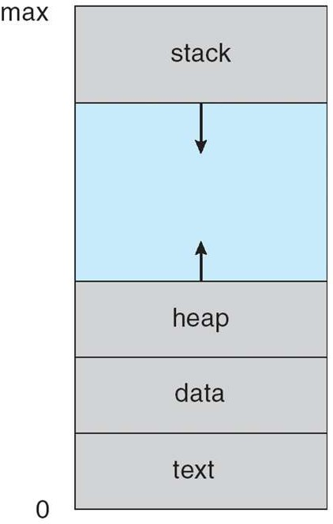
Process Address Space
A list of memory locations from some min (usually 0) to some max that a process can read and write

Slide 5
Relation Between Program And Process
Program is passive entity, process is active
Program: Static code + static data
Process: Dynamic instantiation of code + data + more
Program becomes process when executable file loaded into memory
No 1 to 1 mapping between program and process
One program may run many processes
Separate execution sequences
Multiple users may execute the same program
Text section is equivalent

Slide 6
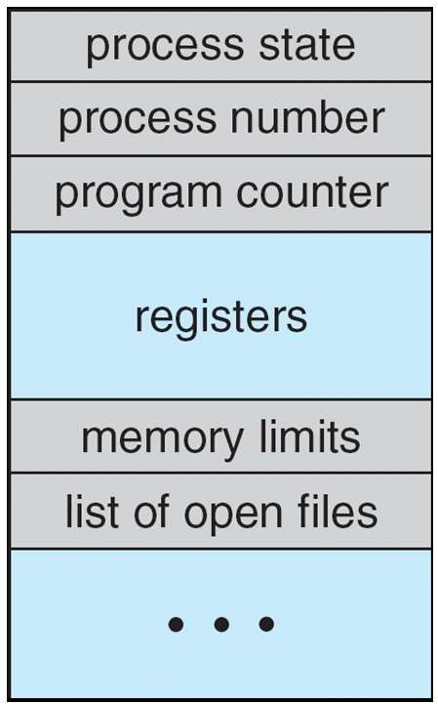
Process Control Block
OS keeps all the data it needs about a process in the process control block (PCB)
Process state
Program counter
CPU registers
CPU scheduling information
Memory-management information
Accounting information
I/O status information

Slide 7
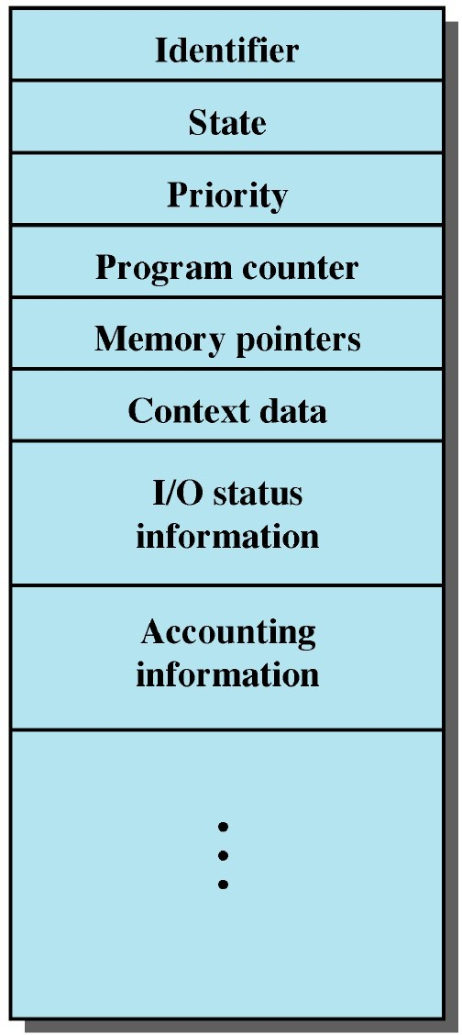
Process Control Block
Distinction between processes
Knowledge on processes ready to execute
Discriminate between processes
Know the next instruction to execute
Find the program and data stored in memory
Keep information about registers
Keep track about resources, e.g., I/O devices
Collect information on utilization of the system

Slide 8
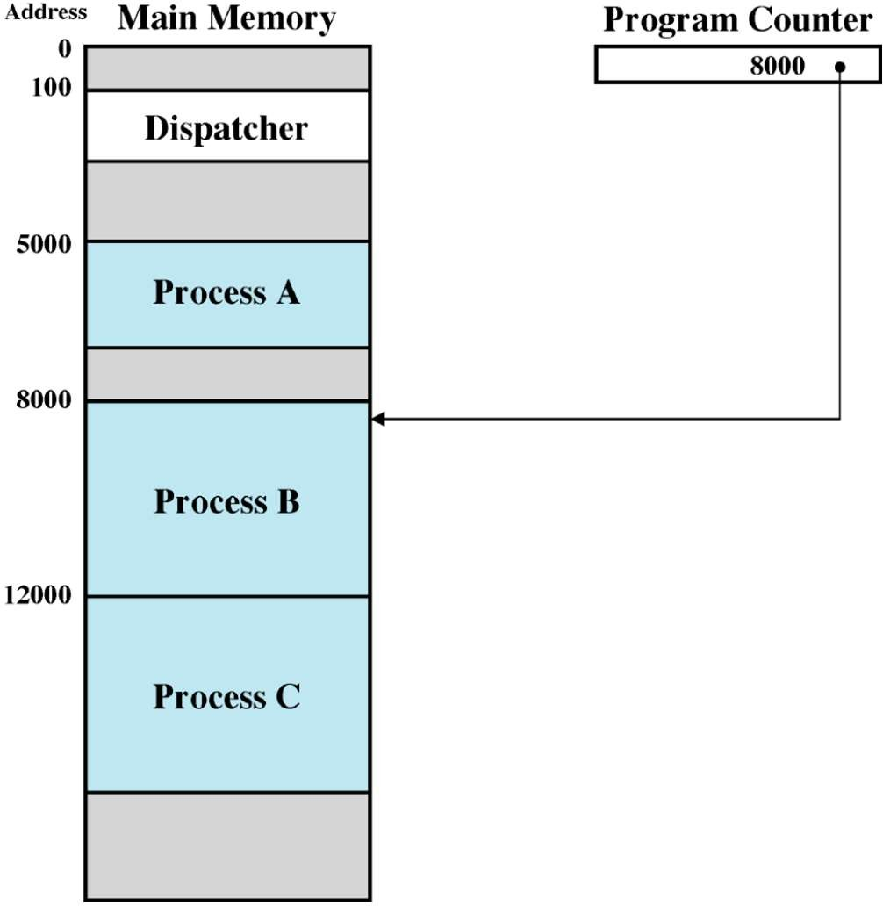
Dispatcher/Scheduler
OS program that decides which process to run next
Uses Process Block Control (PBC) information
– Decision what is the next process to execute

Slide 9
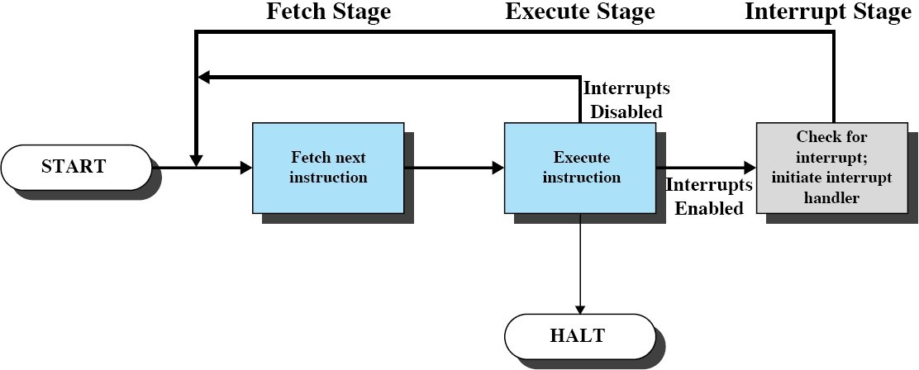
How Does the Dispatcher Gains Control?
Register interrupt handlers
Timeout
I/O request

Slide 10
Execution with Timeouts
On timeout dispatcher gains control
Decides which process to execute next
Dispatcher should perform as few instructions as possible
P₁
P₂ D
t
Timeout
Timeout
Timeout

Slide 11
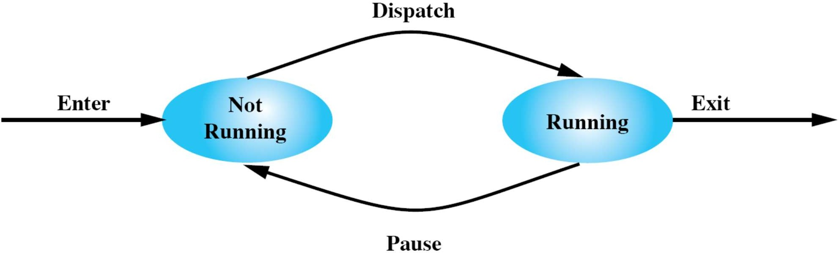
Two-State Process Model
At any time a process is either being executed by a processor or not

Slide 12
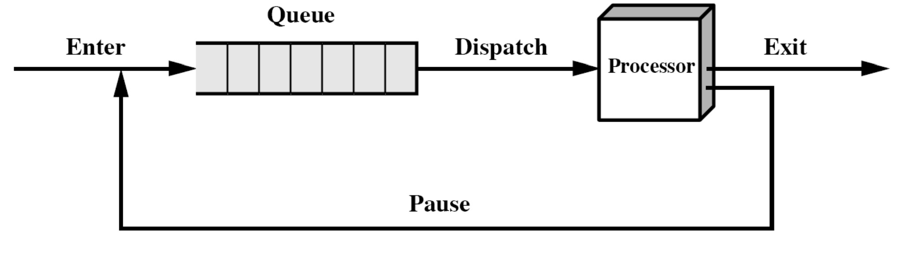
How to Use States for Scheduling?
Queue of not-running processes
Queues
FIFO, Priority Queue
Design goal
Execute only few operations

Slide 13



Is Two Process Model Sufficient?
Ready
Ready
Ready
➔ a := 1
b := a + 1 c := b + 1 read a file a := b - c c := c * b b := 0
➔ a := 1
read a file b := a + 1 c := b + 1 a := b - c c := c * b b := 0
➔ a := 1
b := a + 1 c := b + 1 a := b - c c := c * b b := 0
c := 0

Slide 14
Is Two Process Model Sufficient?
Running
Ready
Ready
➔ a := 1
b := a + 1 c := b + 1 read a file a := b - c c := c * b b := 0
➔ a := 1
read a file b := a + 1
➔ a := 1
b := a + 1 c := b + 1 a := b - c c := c * b b := 0
c := 0
a := 1
➔ b := a + 1
c := b + 1 read a file a := b - c c := c * b b := 0
a := 1
b := a + 1
➔ c := b + 1
read a file a := b - c c := c * b b := 0
c := b + 1 a := b - c c := c * b b := 0
Timeout

Slide 15
Is Two Process Model Sufficient?
Ready
Running
Ready
a := 1
b := a + 1 c := b + 1
➔ read a file
a := b - c c := c * b b := 0
➔ a := 1
read a file b := a + 1 c := b + 1 a := b - c c := c * b b := 0
➔ a := 1
b := a + 1 c := b + 1 a := b - c c := c * b b := 0
c := 0
a := 1
➔ read a file b := a + 1
I/O
c := b + 1 a := b - c c := c * b
b := 0

Slide 16

Is Two Process Model Sufficient?
Ready
Blocked
Running
a := 1
b := a + 1 c := b + 1
➔ read a file
a := b - c c := c * b b := 0
a := 1
➔ read a file b := a + 1
a := 1
b := a + 1
➔ c := b + 1
a := b - c c := c * b b := 0
c := 0
➔ a := 1
b := a + 1 c := b + 1 a := b - c c := c * b b := 0
c := 0
a := 1
➔ b := a + 1
c := b + 1 a := b - c c := c * b b := 0
c := 0
c := b + 1 a := b - c c := c * b b := 0
Timeout

Slide 17
Is Two Process Model Sufficient?
Running
Blocked
Ready
a := 1
b := a + 1 c := b + 1
➔ read a file
a := b - c c := c * b b := 0
a := 1
➔ read a file b := a + 1
a := 1
b := a + 1 c := b + 1
➔ a := b - c
c := c * b b := 0
c := 0
c := b + 1 a := b - c c := c * b b := 0
I/O

Slide 18

Is Two Process Model Sufficient?
Blocked
Blocked
Running
a := 1
b := a + 1 c := b + 1
➔ a := b - c
c := c * b
The Next Process to
a := 1
b := a + 1 c := b + 1
➔ read a file
a := b - c c := c * b b := 0
a := 1
➔ read a file
b := a + 1 c := b + 1 a := b - c c := c * b b := 0
Run cannot be simply
selected from the
front
b := 0
c := 0

Slide 19
Is Two Process Model Sufficient?
Blocked
Blocked
Running
a := 1
b := a + 1 c := b + 1
a := 1
➔ read a file b := a + 1
a := 1
b := a + 1 c := b + 1
➔ a := b - c
c := c * b b := 0
c := 0
a := 1
b := a + 1 c := b + 1
➔ read a file c := b + 1 _{a := b - c} a := b - c a := b - c
c := c * b c := c * b ^{➔ c := c * b}
b := 0 b := 0 ^{b := 0}
Suppose the Green process finishes I/O
c := 0

Slide 20

Is Two Process Model Sufficient?
Blocked
Ready
Running
a := 1
b := a + 1 c := b + 1
➔ read a file
a := b - c c := c * b b := 0
a := 1
read a file
➔ b := a + 1
a := 1
b := a + 1 c := b + 1 a := b - c c := c * b
➔ b := 0
c := 0
a := 1
b := a + 1 c := b + 1
➔ a := b - c
c := c * b b := 0
c := 0
a := 1
b := a + 1 c := b + 1 a := b - c
➔ c := c * b
b := 0
c := 0
c := b + 1 a := b - c c := c * b b := 0
Timeout

Slide 21
Is Two Process Model Sufficient?
Blocked
Running
Ready
a := 1
b := a + 1 c := b + 1
➔ read a file
a := b - c c := c * b b := 0
a := 1
read a file
➔ b := a + 1
c := b + 1 a := b - c c := c * b b := 0
a := 1
b := a + 1 c := b + 1 a := b - c c := c * b b := 0
➔ c := 0
a := 1
read a file b := a + 1
➔ c := b + 1
a := b - c c := c * b b := 0
a := 1
read a file
Timeout
b := a + 1 c := b + 1
➔ a := b - c
c := c * b
b := 0

Slide 22
Limitations of Two Process Model
Timeouts: The process with highest priority will be dispatched to the CPU (… regardless of its capabilities!)
Wasteful in case of
Waiting for I/O operations
Waiting for access to a resource
In this case dispatcher cannot select the process at the front
In worst case dispatcher has to scan the whole queue
Add more states …
Waiting (i.e., blocked), ready

Slide 23
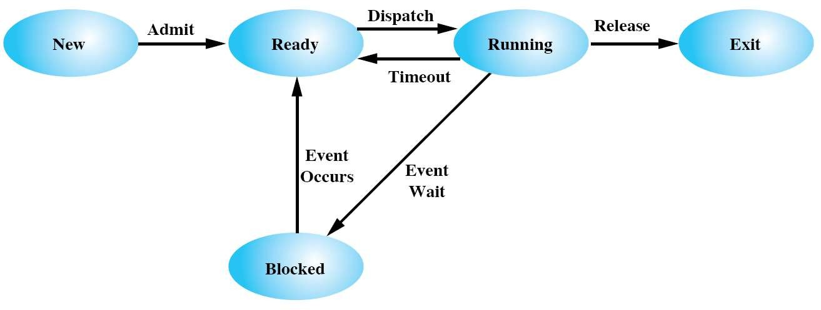
Five State Model
Terminated
Waiting
Admittance to control resource usage
Processes which need to wait for events can be blocked

Slide 24
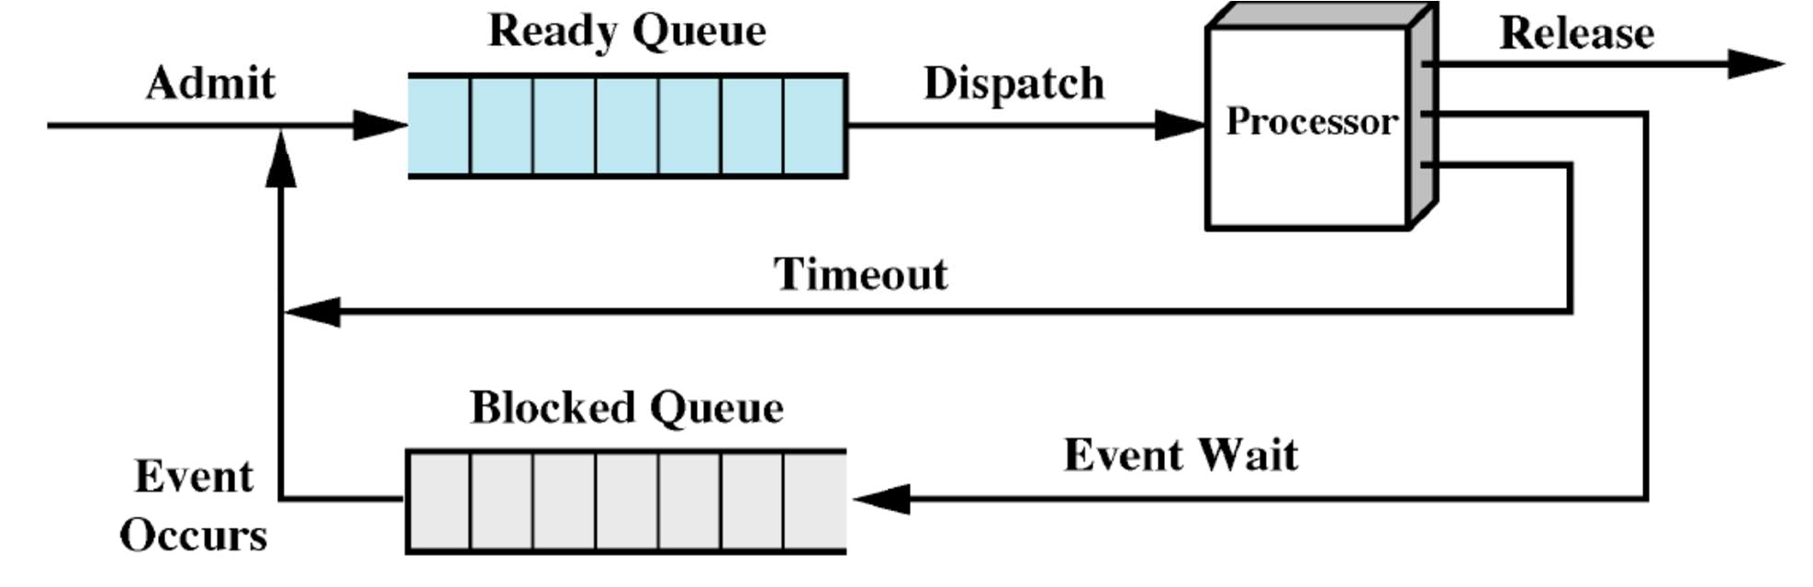
How Can the Dispatcher Use the Five States?
Maintain different queues
One for ready processes
One/many for blocked processes
How expensive is it to transfer a process from blocked to ready state?

Slide 25
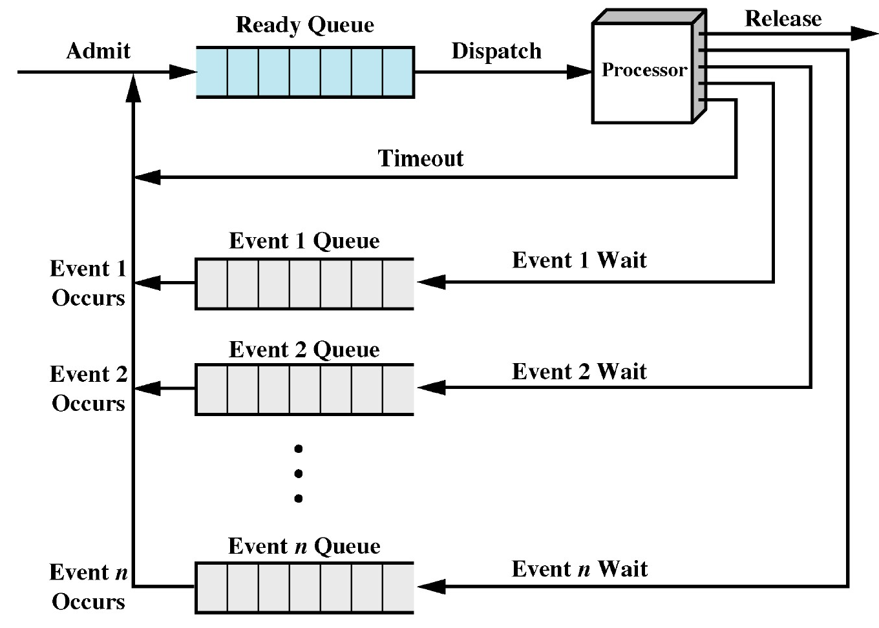
Using Multiple Queues
Dispatcher can efficiently react to distinct events in the operating system …
One queue per event
O(1) operation to transfer process from running to blocked state
O(1) operation to transfer process from blocked to ready state
Low dispatch latency

Slide 26
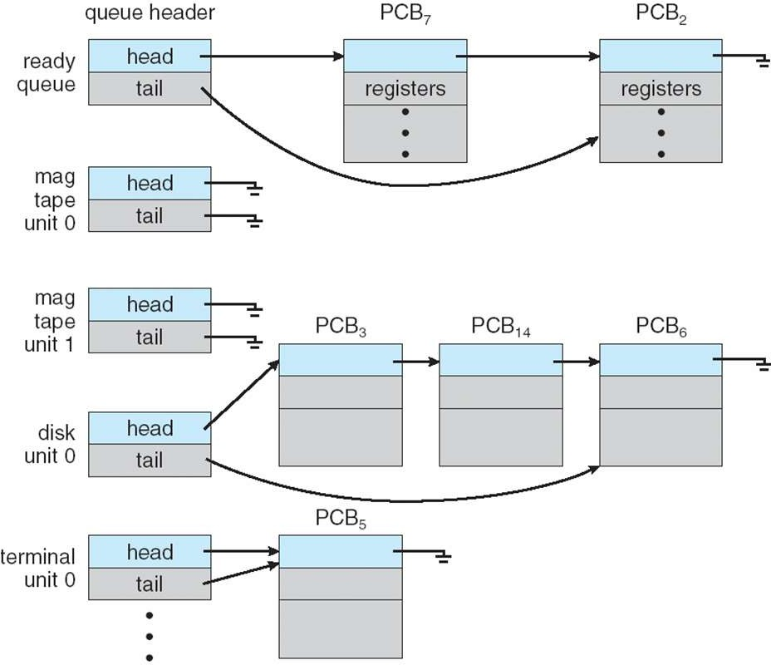
Using Multiple Queues: Ready And I/O Queues

Slide 27
Limitations of the Five State Model
Available resource usage depends on the number of processes deployed
For example, the available memory drops with the number of actively running processes
Low hit rate in accessing the memory hierarchy and slow performance
Idea: Swap some processes to disk
For example, free up more memory and achieve higher hit rate for other processes
Process is in suspend state when swapped to disk
Nothing of the process image resides in main memory!

Slide 28
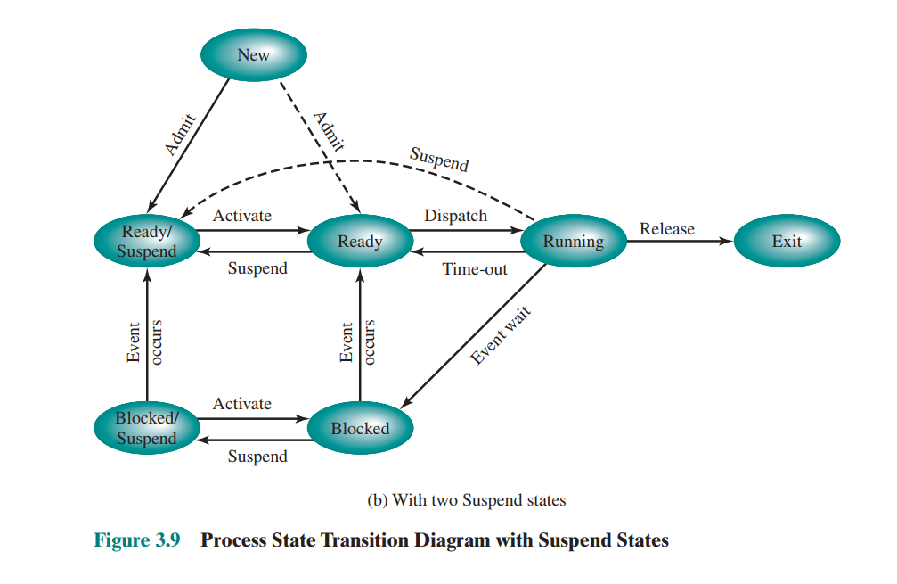
Process state transition diagram with suspend states

Slide 29
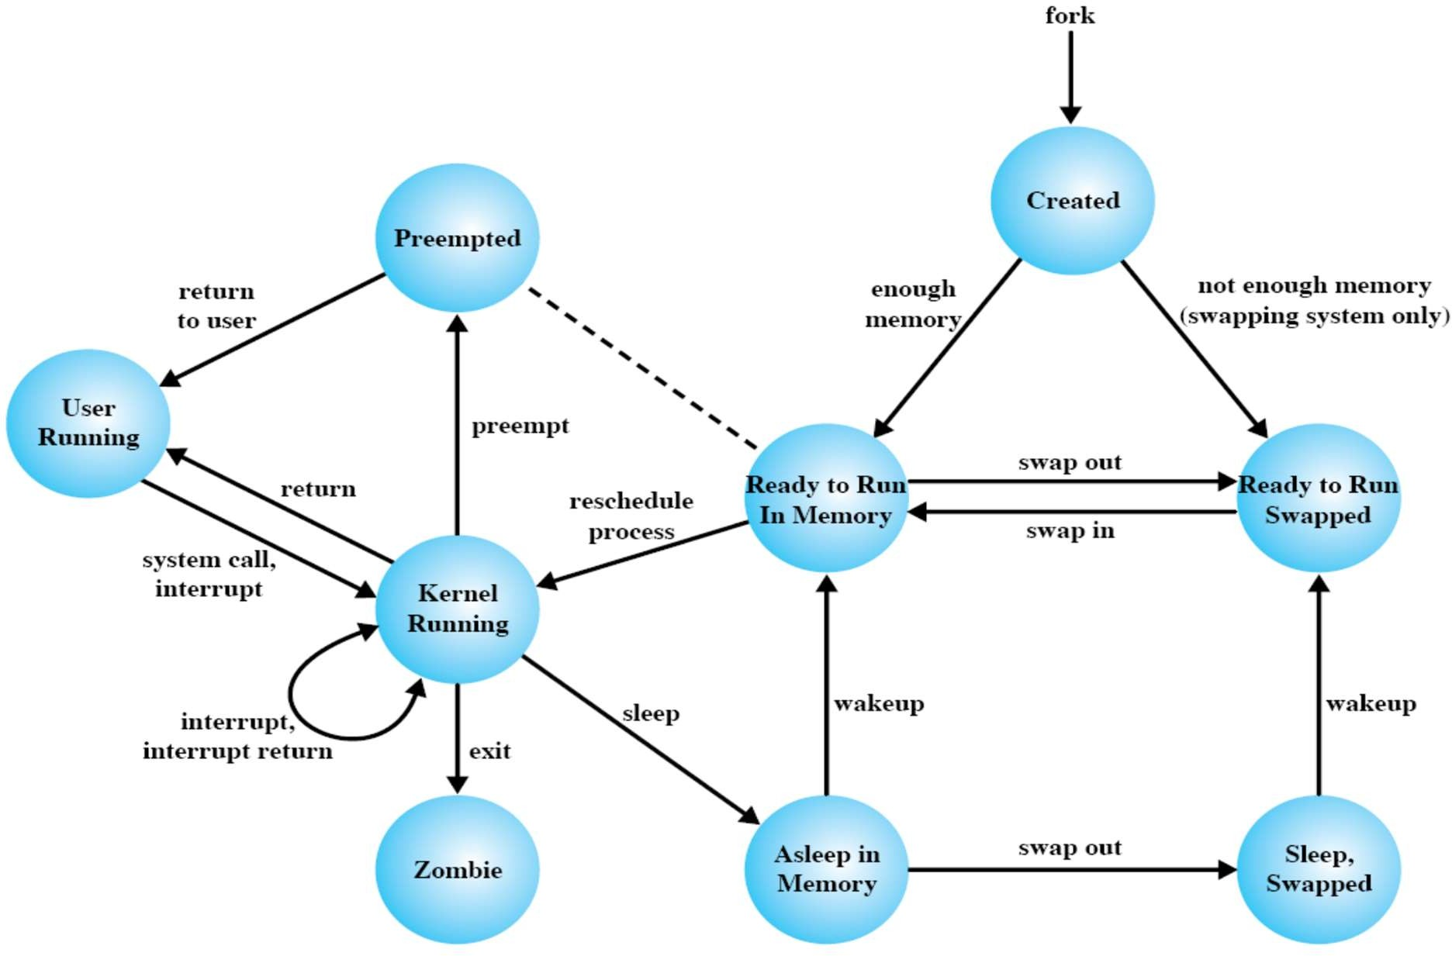
Unix V Process State Transition

Slide 30
Context Switching
Context of a process represented in the PCB
When CPU switches to another process, OS must
Save context of processor including program counter and other registers (in PCB)
Move PCB to appropriate queue (ready, blocked, …)
Select another process for execution
Update the PCB of the process selected
Update memory-management data structures
Restore context (in processor) of the selected process
Context switch time is overhead
The system does no useful work while switching
Time is also dependent on hardware support
For example, some hardware provides multiple sets of registers per CPU

Slide 31
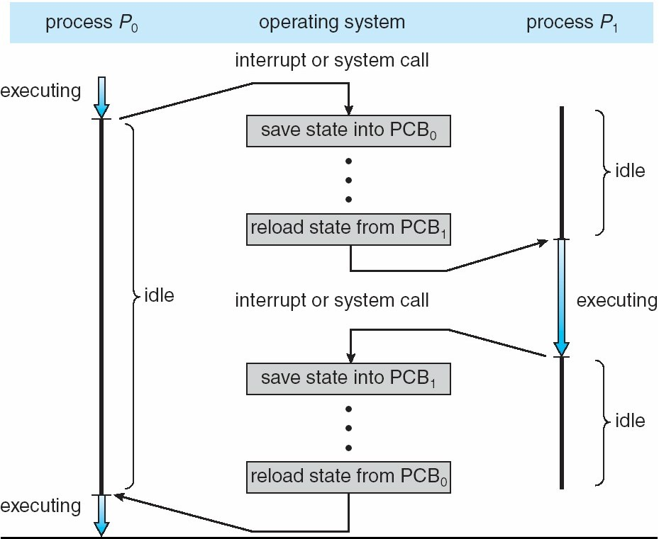
Context Switching

Slide 32
Process Creation

Slide 33
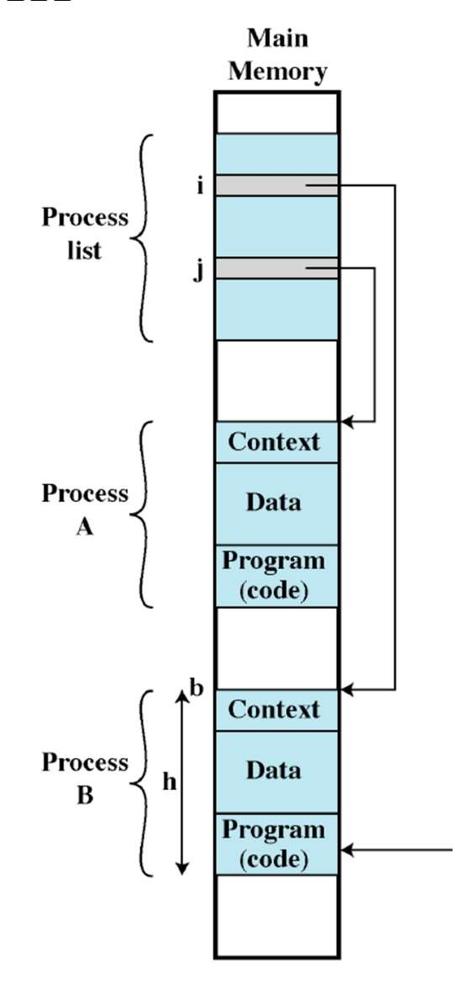
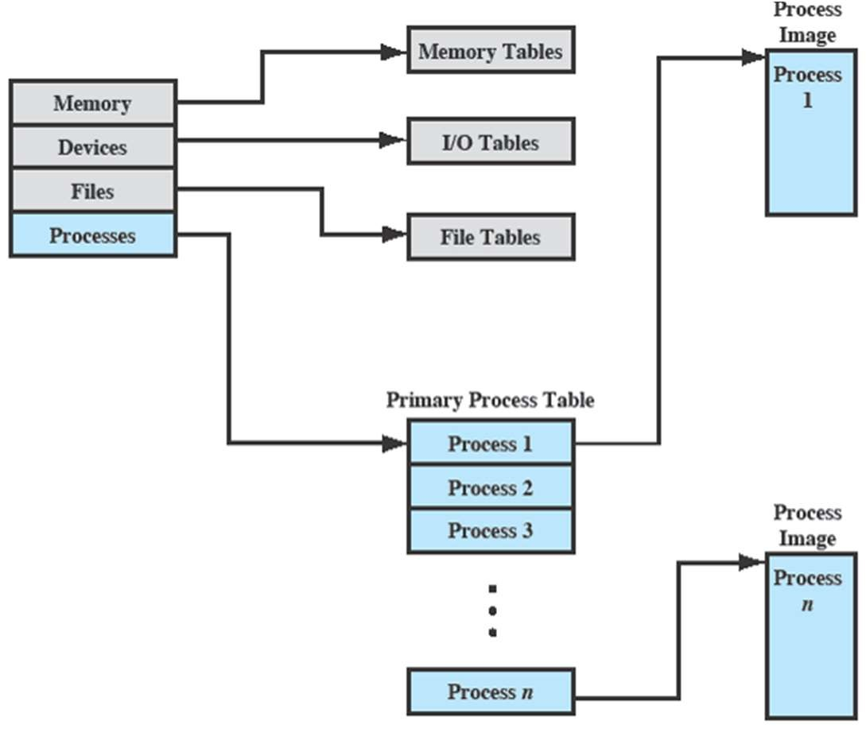
Process Creation
Assign a unique identifier (pid) to the new process
Allocate space for the process
Initialize PCB
Process table
Process A
Process B

Slide 34

Process Creation
Assign a unique identifier (pid) to the new process
Allocate space for the process
Initialize PCB
Setup appropriate linkage
– E.g., add to ready or ready suspend queue
Create or expand other data structures
Process table
Process A
Process B

Slide 35
Process Creation
Traditionally, the OS created all processes
But it can be useful to let a running process create another
This action is called process spawning
Parent Process is the original, creating, process
Child Process is the new process

Slide 36
Process Creation
Parent process create child processes, which, in turn create other processes, forming a tree of processes
Process identified and managed via a process identifier (pid)
Resource sharing
Parent and children share all resources
Children share subset of parent’s resources
Parent and child share no resources
Execution
Parent and children execute concurrently
Parent waits until children terminate
Address space
Child duplicate of parent
Child has a program loaded into it

Slide 37
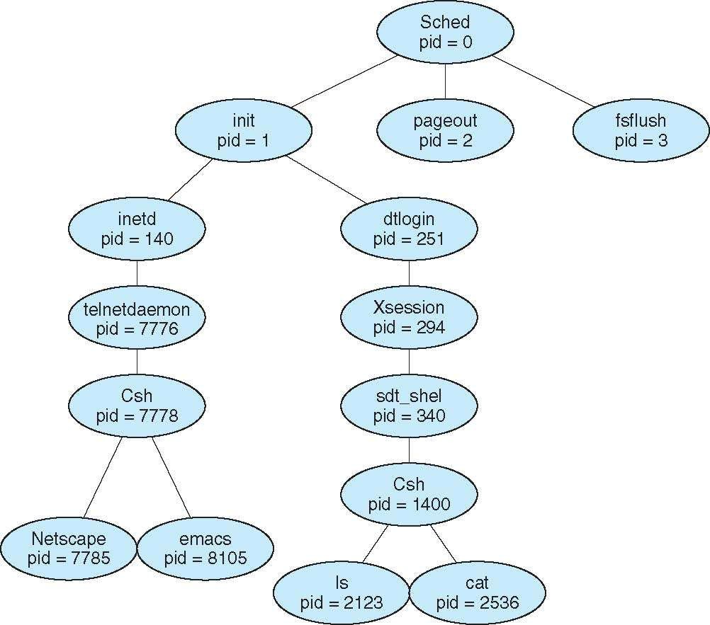
Process Tree on Solaris

Slide 38
Process Creation in Linux
fork system call creates new process
The fork syscall returns a zero to the child and the child
fork creates an
exact copy of the parent process
int pid;
int status = 0;
Parent uses wait to sleep until the child exits; wait returns
process ID to the parent
pid = fork(); if (pid>0) {
/* parent */
……
pid = wait(&status);
} else {
/* child */
…… exit(status);
}
child pid and status.
wait variants allow wait on a specific child, or notification
of stops and other signals
Child process passes status back to parent
on exit, to report success/failure

Slide 39
fork() System Call
Child process inherits
Stack
Memory
Environment
Open file descriptors
Current working directory
Resource limits
Root directory
Child process does not inherits
Process ID and parent process ID
Timers and pending signals
Resource utilization and CPU times (initialized to zero)
Memory and file locks

Slide 40
Zombie (or Defunct) Process
A process that has completed execution but still has an entry in the process table
Process table entry is needed to allow the parent process to read the child's exit status
Parent can read the status by executing the wait() system call
No memory allocated to zombie process except for the process table entry
On exit, all of the memory and resources are deallocated
However, process table can only have limited number of entries

Slide 41
Orphan Process
An orphan process is a process that is still executing, but whose parent has terminated
If the parent terminates without calling wait(), the child is adopted by init
Orphan processes do not become zombie processes
init periodically executes the wait() system call to avoid zombie processes

Slide 42
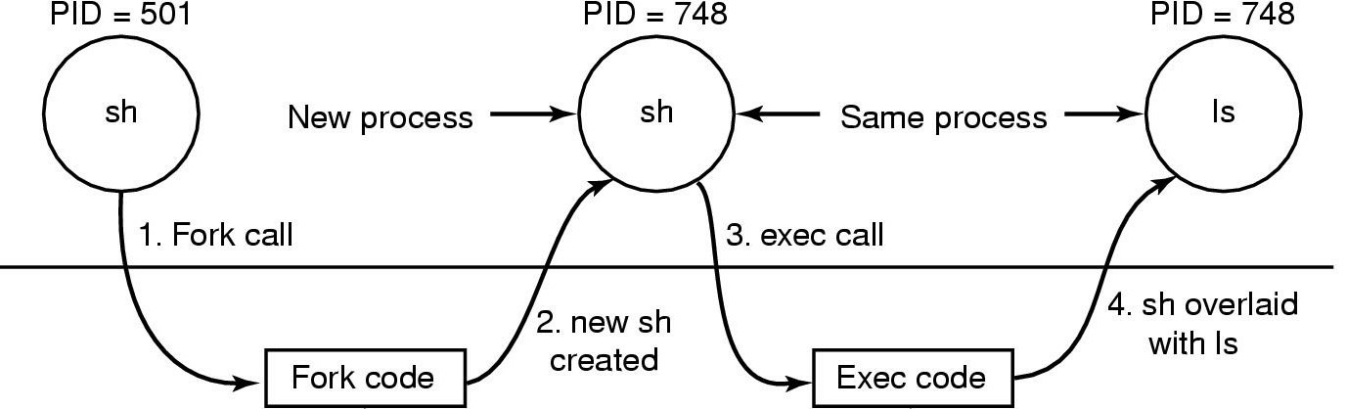
exec() System Call
Enable child process to run other program
Replaces process’s memory space with a new program
Loads binary file into memory and starts its execution
Cannot create new process
Typically used after fork()
Steps in executing the command ls issued to the shell

Slide 43
exec() System Call Example
int main(int argc, char *argv[])
{
pid_t cpid; cpid = fork();
if (cpid == -1){
perror("fork"); exit(EXIT_FAILURE);
}
if (cpid == 0) {
/* Child code */
execlp (“/bin/ls”, “ls”, NULL);
/* Why no exit statement*/
}
else {
/* parent code */ wait(NULL); printf(“child finished”); exit(EXIT_SUCCESS);
}
}
2-Process
42

Slide 44
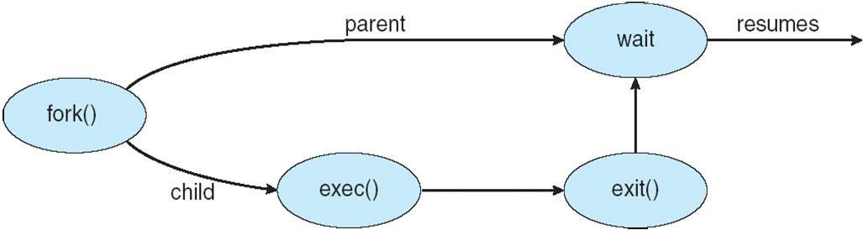
exec() System Call Example

Slide 45

Any Question So Far?
2-Process
91

